Slide 1


CV? Résumé?
Presentation by:
Alireza Bahramali

Slide 2

Importance
(Somehow) The most important thing that represents you!
The first (and if not appropriate, maybe the last  !) thing to represent you!

Slide 3
CV vs. Résumé
Résumé (not very popular in apply process)
Very short and brief (one or two pages)
Typically includes the following:
Name and contact information
Education (degree, dates, institutions, programs.)
Work experience (names of companies or organizations, locations, dates, job titles, duties.)
CV
All other slides!

Slide 4
Curriculum Vitae
Again, it’s almost all that represents you to the admission team/professor/etc.
You should highlight your strengths and dim your weaknesses, but never lie!
It should have order.

Slide 5
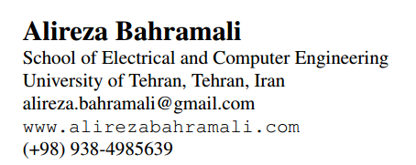
CV, Main Parts
Name
Contact information
Email
Website
Photo (optional)

Slide 6
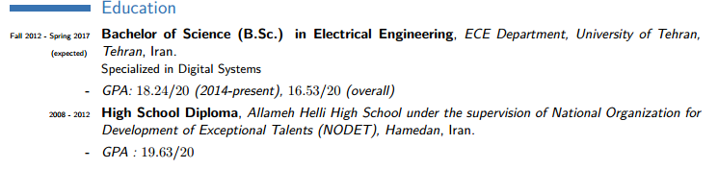
CV, Main Parts
Education
Calculating GPA (out of 4), if needed (www.wes.org)
16-20 = 4 , 14-16 = 3, 12-14 = 2, 10-12 = 1
Highlight what you need
Last one/two years
Special courses
Special case
Be aware of formatting

Slide 7
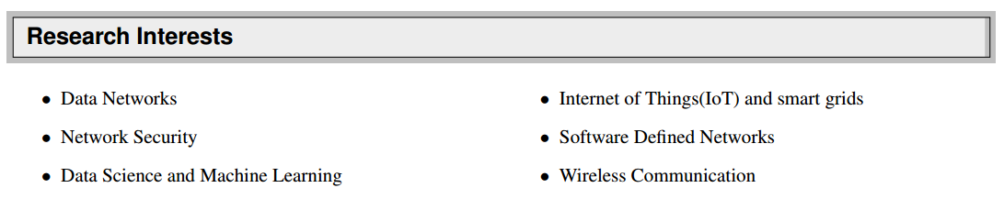
CV, Main Parts
Research interests
Not too much
Related to each others
May need updates!

Slide 8
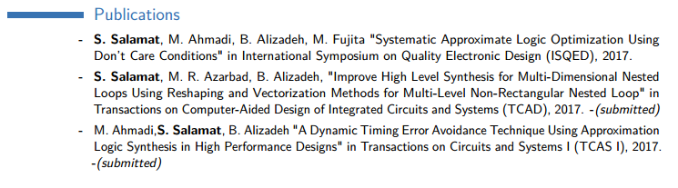
CV, Main Parts
Publications and Patents
Do not forget your submitted, accepted but not published or presented, or self-declined work.
Mention the status.
Hyperlink to the paper or it’s abstract, and the journal’s/conference’s website.

Slide 9
CV, Main Parts
Research Experience
Group by laboratory/professor
Name the professors/supervisors
Mention any mentionable (!) work you were involved with (be moral!)
Never forget literature reviews
Hyperlink to any available (and publishable!) material (slide, report, etc.)
Do mention ongoing research (and also do mention that it’s not finished yet!)
Mention your intern if it was in a Lab

Slide 10
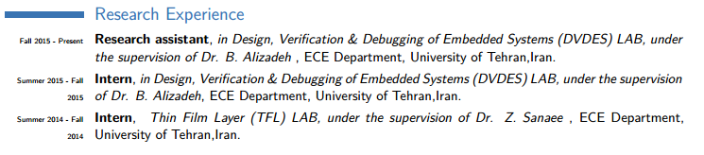
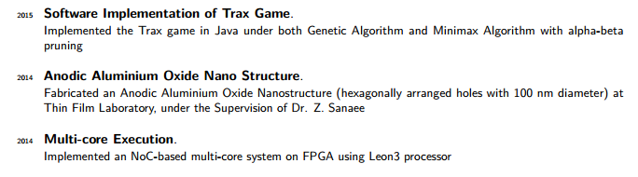
CV, Main Parts

Slide 11
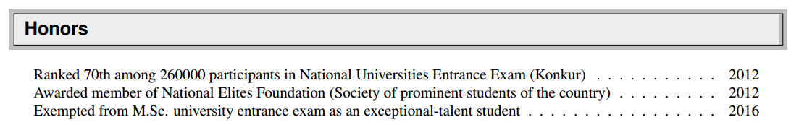
CV, Main Parts
Honors and Awards
Mention the dates
Give short explanation (highlight!)
Please forget about your elementary school!

Slide 12
CV, Main Parts
Course Projects
Related notable projects
Do not mention all the projects!
Selected Courses
Related courses with high grade
No more than 8 courses
Self-Study (optional)
Coursera, Edx!
Audit

Slide 13
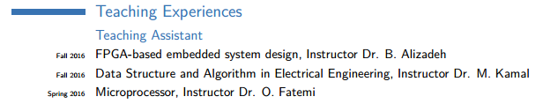
CV, Main Parts
Teaching Experience
Mention the course name, professor, and the dates.

Slide 14
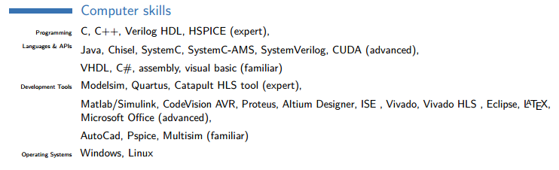
CV, Main Parts
Computer skills
Group by subject(optional), then software
Mention some projects(optional)

Slide 15
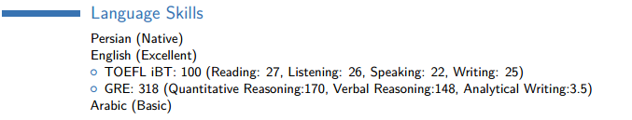
CV, Main Parts
Languages and test scores
Group by language, then by test, and mention your scores at each section
Mention any language, even if you don’t have a degree for it! (Be moral again!)

Slide 16
CV, Main Parts
Working experience
Internship
Leadership experiences
Volunteer Experience
Technical skills
Professional memberships
Hobbies (!?!)

Slide 17
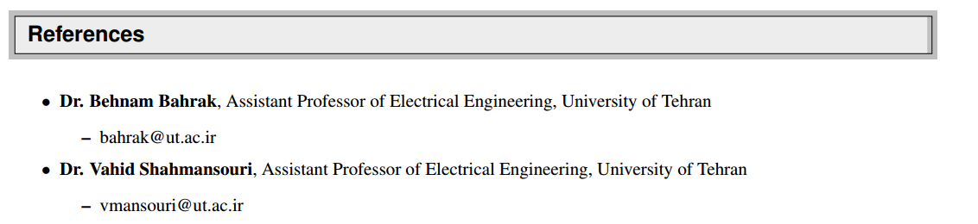
CV, Main Parts
Reference
Too much important! More than you may think of!
You should name anyone you mentioned in your CV and give a brief explanation, and a contact link, preferably personal homepage on the university website or email, via a hyperlink.

Slide 18
Dos and Don'ts
There is no universal guideline, these were the best things I could tell you!
No JigoolBaaZi in fonts and margins and formatting, as you know it.
Some universities require special formatting, take care.

Slide 19
Dos and Don'ts
Always get help from friends in formatting, grammar, and dictation (although Microsoft helps a lot).
Again, remember to be moral, and never lie!
Again, do not forget highlighting techniques!
No more than 3 pages, and never repeat anything.

Slide 20
Dos and Don'ts
You may try some online tools, such as
cvmkr.com
Google docs
Etc.
You may try LaTeX
Free templates (search in google)
www.latex-project.org

Slide 21
Publication & Researchs
Great impact on your resume
Covers your low GPA
Strong letters of recommendation
Puts you ahead of the competition
How to Apply 94 http://www.ieeesb.ut.ac.ir mdahmardeh@ut.ac.ir

Slide 22
Homepage

Slide 23
Why?
The World of the Internet
Easy for professors
Searchable

Slide 24
Content
Biography
Research activities
Teaching activities
CV
Contact info

Slide 25
How?
Expert web developers
HTML, CSS, JQuery, …
Semi-expert web developers
Frameworks: bootstrap, foundation, …
Amateur
Free templates
Online drag and drop tools

Slide 26
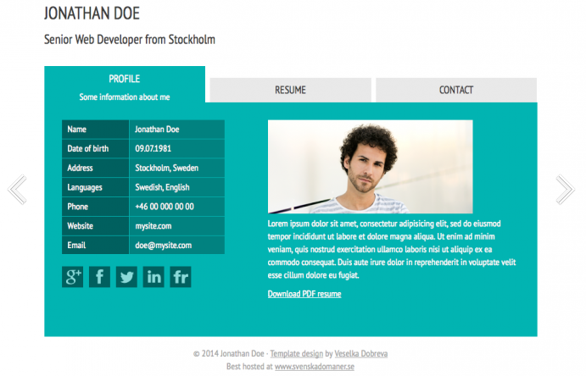
Free Website Templates
http://andreasviklund.com/
Find more on the Internet
Read tutorials on building your first website

Slide 27
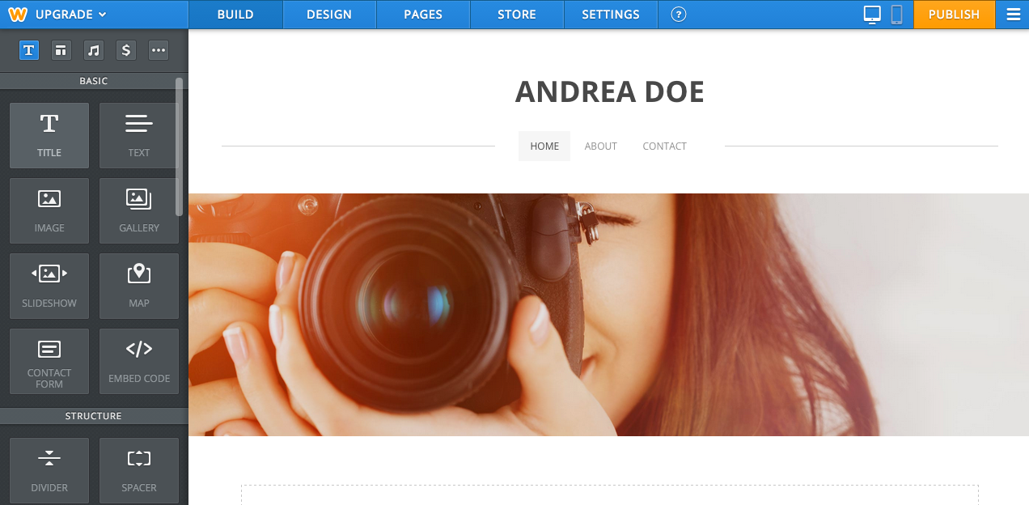
Online Drag and Drop Tools
http://www.weebly.com/ or http://www.webs.com/
Different themes
Simple widgets for design

Slide 28
Design
Limit the depth
Make simple and easy to read
Colors
Responsive
Consistent
Design like it is a billboard.

Slide 29
Domain and Server
Domain
.ir/.net/ .com/…
Server
Reliable
Responsive
Location
Simple options (No RAM or CPU)

Slide 30
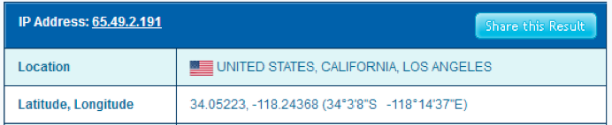
Statistic
Google Analytics
Persianstat
Yesware
Host-tracker
…
IP2Location.com

Slide 31

Thanks!
A lot!

